Slide 1
Business Proposals: Types And Content

Slide 2
There are several ways to categorize types of proposals.
Variation in Audience
Internal : Within your organization
External : Outside your organization
Variation in Audience Interest
Solicited: Requested (often through an RfP or RfQ)
Unsolicited : Usually not expected
Variation in Formality
Informal (i.e., sent via email or memo)
Formal (what we’re doing in this project)
Variation in Types/Goals
Sales Proposals: Market or sell products or services
Grant Proposals: Secure funding
Change Proposals: Identify and solve an organizational or business problem
Variation in How Many Proposals are Being Considered
Non-Competitive (or “Single-Source”): Only one company is contacted to submit a proposal
Competitive: An organization solicits proposals from multiple companies and negotiates the best bid & fit for their project

Slide 3
Regardless of type, “winning” or effective proposals should:
Demonstrate a robust understanding of the audience/client’s problem or need.
  May require background research to understand or show evidence of the problem.
Have a compelling solution/strategy/plan for addressing the problem and achieving the desired results. (Problem/Solution Fit.)
Give evidence of feasibility (through specific budgets, timelines, and/or implementation plans)
Provide evidence of qualifications to implement the solution/plan.
Emphasize benefits of your solution/plan.
Have “sales moxie” : use effective persuasive strategies (ethos, pathos, logos)

Slide 4
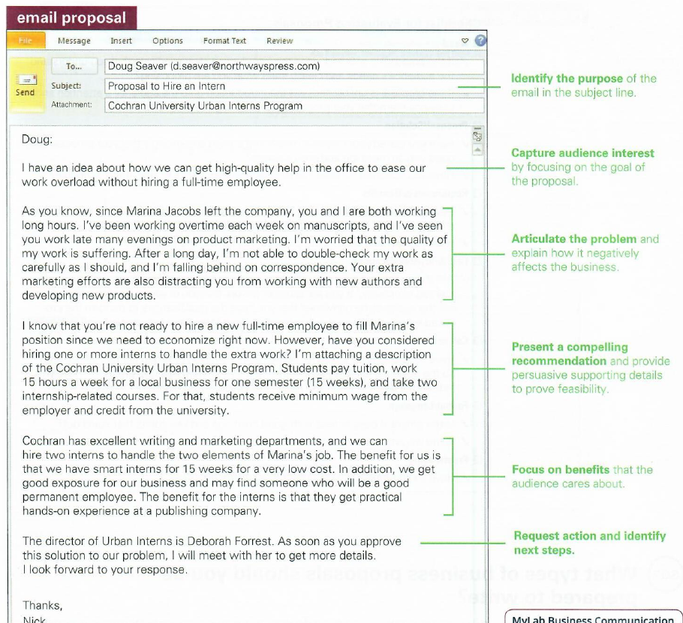
Sample informal internal proposal to solve a business problem.

Slide 5
Typical sections of formal proposals
Title Page
(Transmittal Memo)
Executive Summary
Table of Contents
Identification of Problem/Need/Opportunity
Identification of Solution (Plan, Methods/Approach)
Specifics of Implementation (Timeline, Budget, Materials Needed)
Explanation of Benefits of Your Solution/Plan
References
Appendix

Slide 6
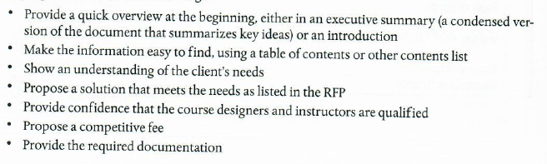
Solicited Proposals: Responses to RfPs
RfPs usually provide very detailed, specific requirements of what proposals must include. (See sample on Canvas.). Proposals should

Slide 7
Emphasizing Benefits
Emphasize the benefits to your audience of *solving the problem* (particularly for unsolicited proposals.)
Emphasize the benefits of *your solution* (your plan for implementation, particularly if you are competing with other proposals.)

